Slide 1
Introduction to Flex MLS and
ZIP FORMS

Slide 2
FLEX MLS
Searches, Subscriptions and Statistics

Slide 3
Course Outline
The class will be interactive and you will need access and ability to navigate your MLS account while watching the presentation. If you do not have two screens, we recommend logging onto the class with a cell phone or tablet and navigating your MLS on another device. We will be using desktop version MLS.
Following the training you should be competent in a variety of search methods and exporting the searches, using the search methods to create subscriptions.
Adding the subscriptions to clients contacts and using contact management as a basic CRM.
We will explore a number of statistics available on FLEX and how we can interpret and use the data for marketing purposes.

Slide 4
Course Outline cont….
We will explore ZIPFORMS Dashboard and how it can be used to manage your business
Speed up and standardize your transaction setup with templates
Go paperless with E Sign

Slide 5
HELP !!!!!!!
Help tutorial
Flex have created a dynamic tutorial HELP button in the top right of your screen, The tutorial will provide help topics specific to the page you are on or a help search for any topic within FLEX, there is also a useful video library of trainings on almost all topics.

Slide 6
Searches made easy
Quick Search
“Add field” edit search
Categorized alphabetically by the main headers of the “Details” tab when adding a listing
“Top Tip” when searching for a building name, only search condos
Map Search - Shapes
Rectangle
Circle - distance
Useful for establishing distances from areas, e.g. doctor needs to be 10 mins from GMH
Polygon - defined areas
Identifying sub divisions or boundaries and properties within or outside of defined areas

Slide 7
Exercise 1
Your client is a doctor and has a clinic in Tamuning. Due to “on call” reasons she must be within 3 miles of GMH and GRMC.
Searching with quick search and circle shape
Quick Search the following criteria
Residential For rent
$2500 - $4000
Min 3 bed
Min 2 bath
Within 3 miles of GMH
How many listings pending and active?

Slide 8
Exercise 2
Using your search results from exercise 1.
NOT WITHIN circle
How many listings?
Draw a circle 3 miles from GRMC
How many listings total (both circles)?
Not within circles
How many listings?
Intersection of both circles
How many listings?

Slide 9
Save Search
Now that we have established the search criteria for our doctor we will save the search.
Using Intersection of both circles
Save search
Give search name and add any details about the search
New, Existing or No contact
Add new contact
Add subscription

Slide 10
Subscriptions and Contacts
Subscriptions are the process of connecting your contacts to your searches
Contacts
Using Flex as a CRM

Slide 11
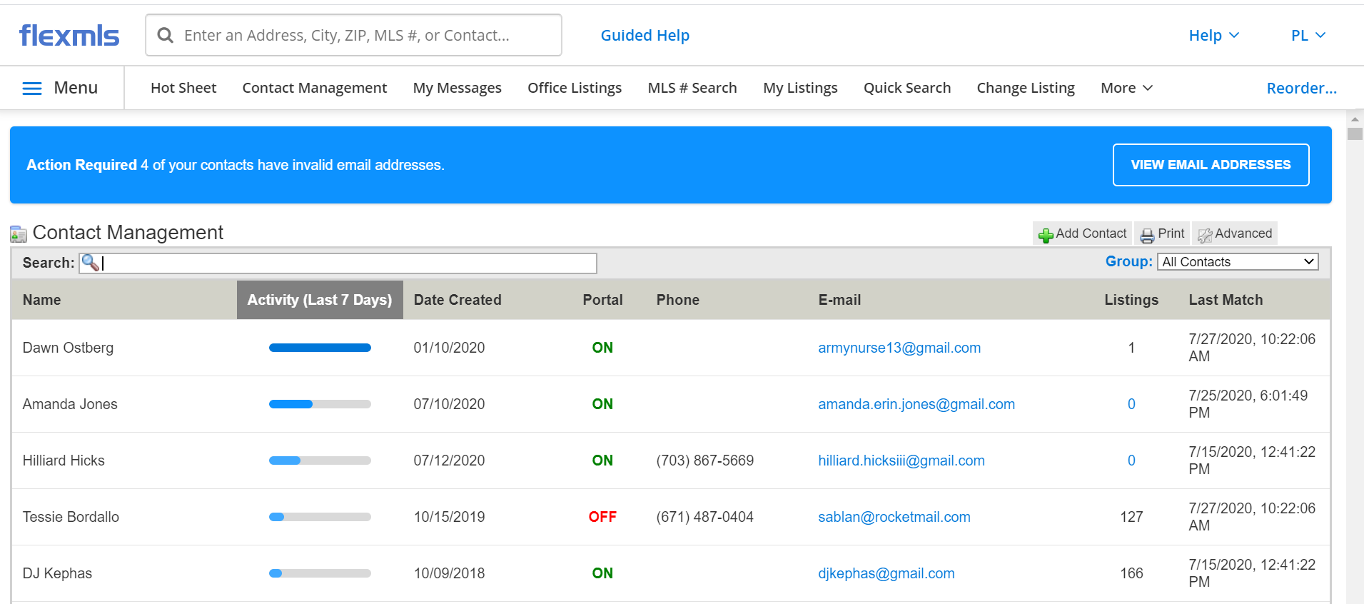
Contacts and CRM

Slide 12
Statistics
Why use statistics?
Be a knowledge base for your clients
Understand the market trends
Make informed decisions on actual circumstances
Know who, where and which markets your competition is working in

Slide 13
Reports
Sold Market Analysis
This report allows you to compare statistics for sold properties for this year and last year (or any two years). Days on market information is included, as well as average and median sold prices.
Supply and Demand
This report helps you compare the supply (active listings) with the demand (sold listings) for each area in the MLS.
Buyer market 7+ months
Sellers Market 1-3 months
Neutral Market 4 - 6 months
*The absorption rate is an estimate of the rate at which a particular classification of properties for sale or lease can be successfully marketed in a given area. To analyze supply and demand, an absorption rate must be developed.
To calculate absorption rate, you need to determine the number of competitive properties currently on the market and divide that number by the number of properties that have been selling per month.
The recommendation is to go back three months to determine the average absorption rate and then compare this figure with just the previous month’s absorption rate to see the trend:
* courtesy of NAR “Pricing Strategies: Mastering the CMA

Slide 14
Zip Forms
Templates and E signature

Slide 15
DASHBOARD
Largely underused feature of zipforms by most agents
Captures pipeline, transaction progress and timelines
Commissions, sales volumes and closed transactions
The data is only as good as the information you put in!

Slide 16
TEMPLATES
Setting up a template
Navigate to the templates tab
Just Like setting up “transaction”, determine the type of transaction the template will represent
Open and new template
Complete the template details as you would a transaction
Add template documents from the library

Slide 17
E signatures
Zip forms has three built in e signature services
Docusign
Digital Ink 2.0
Digital Ink 1.0
User preference and each has its positives and negatives
From your Transaction page, open a NEW transaction, complete the transaction details
You would now complete the ZIPFORM records that populate the DashBoard.
From the Documents tab you would complete the documents.
E - Signature
From the documents tab click E-sig

Slide 18
Thank you all for your participation

Slide 19
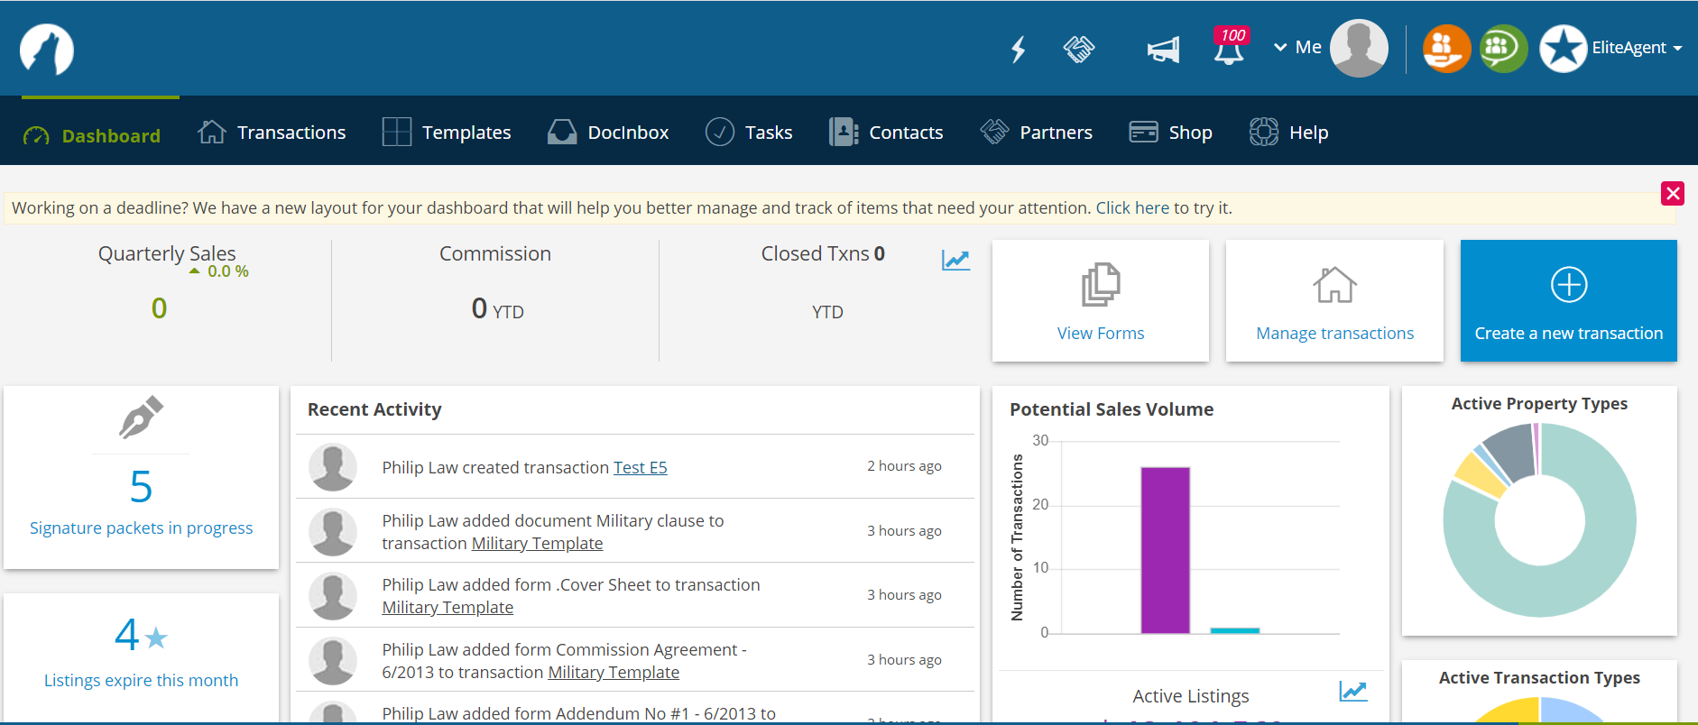
DASHBOARD

Slide 20
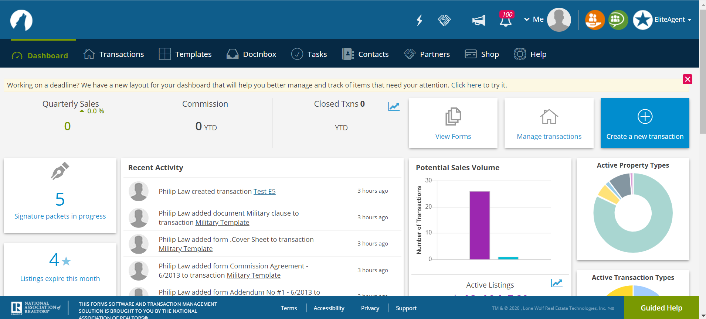
Templates

Slide 21
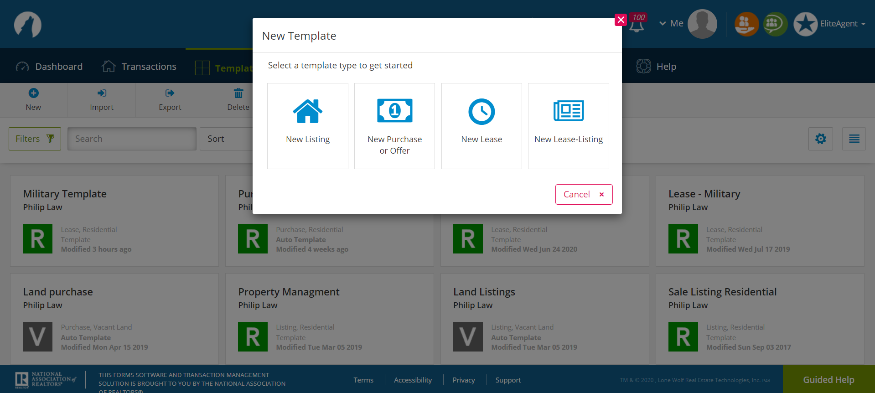
Open a template

Slide 22
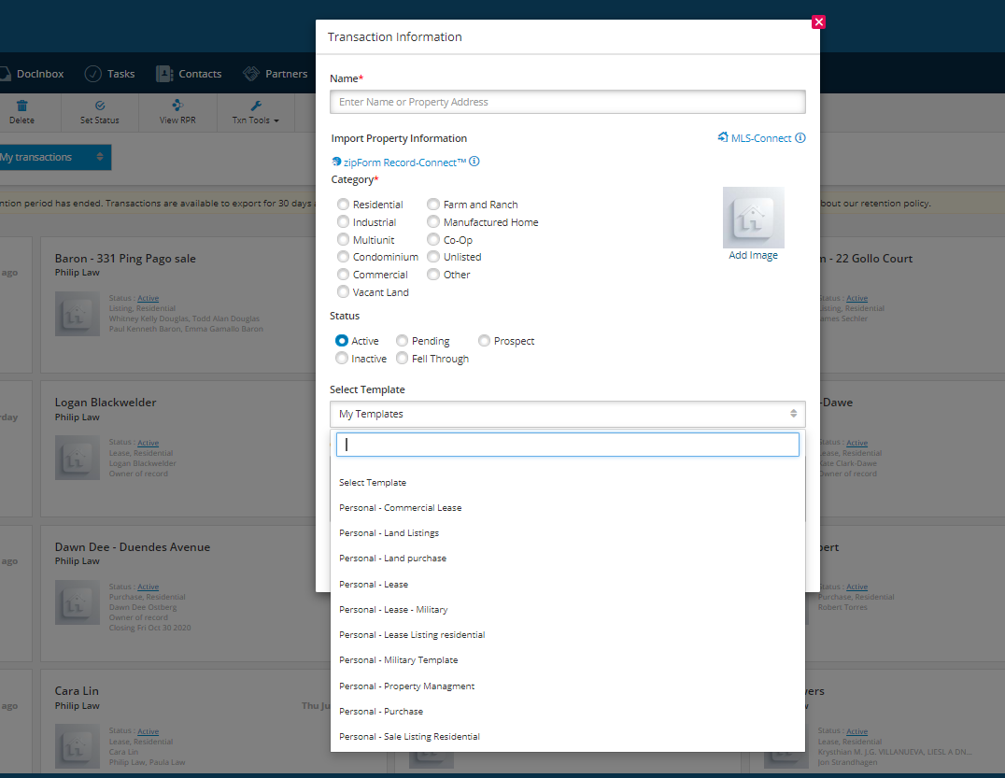
New Transaction

Slide 23
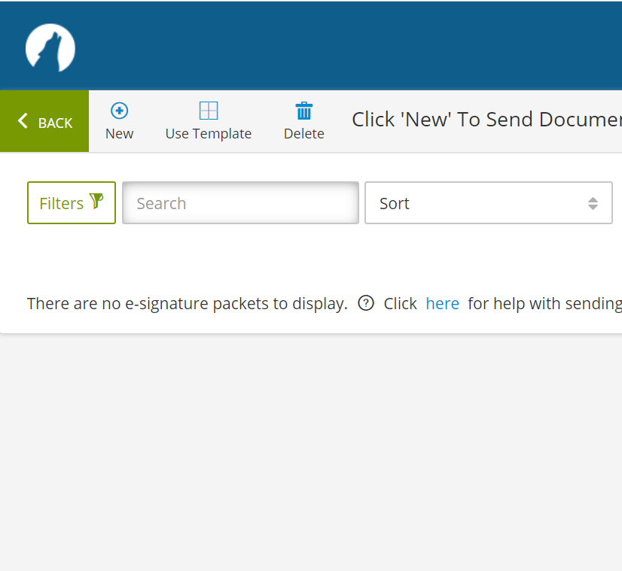
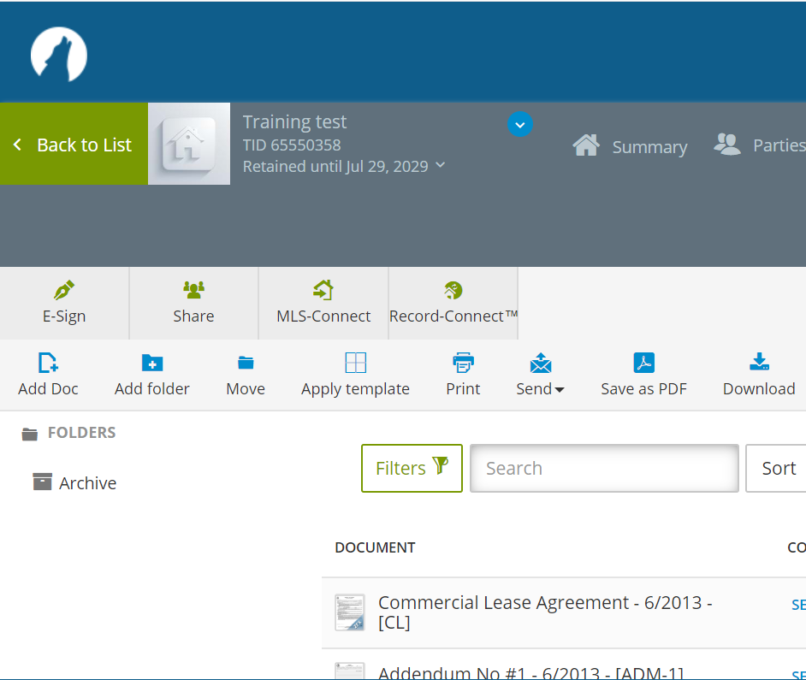
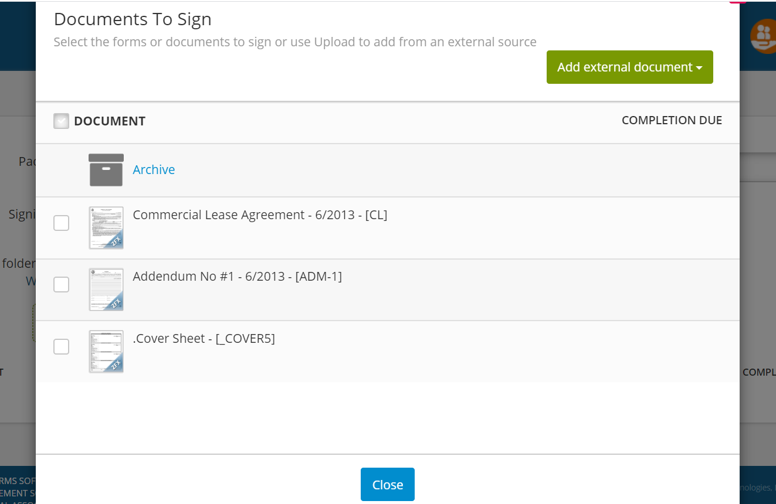
E Sign

Slide 24
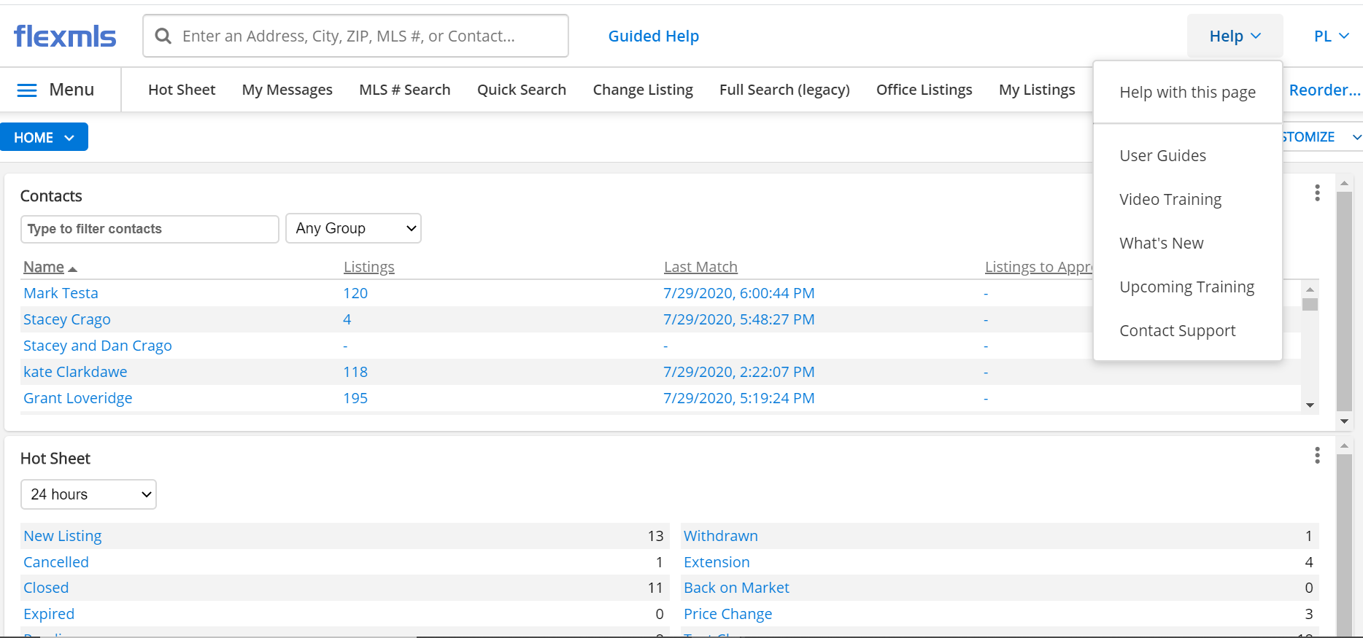
HELP

Slide 25
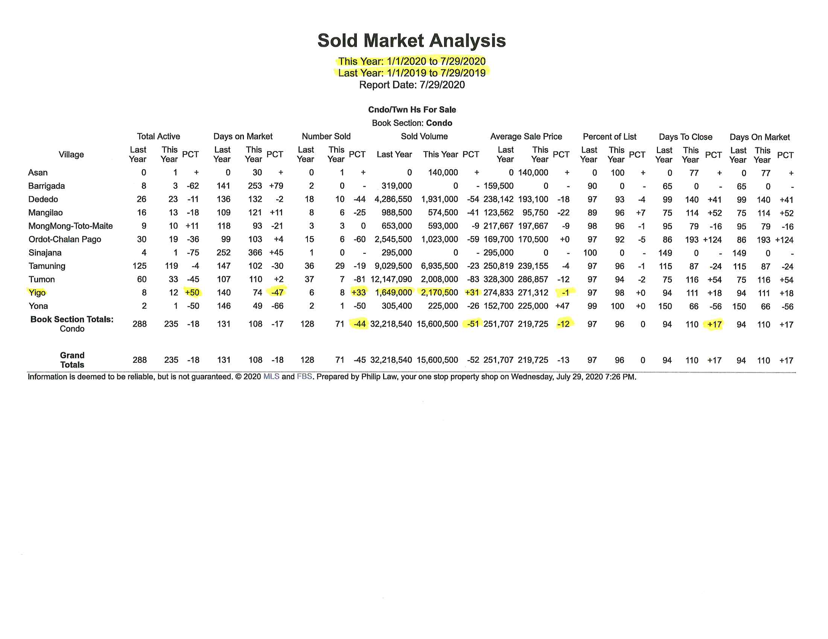
Sold Market Analysis report…

Slide 26
Sold Market Analysis

Slide 27
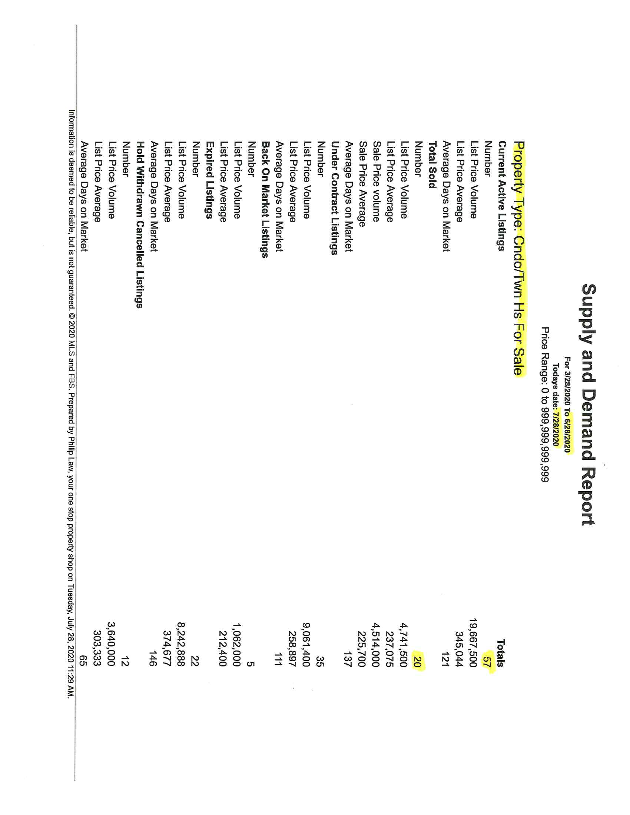
Supply and Demand report

